Slide 1
Splash Screen

Slide 2
Lesson Menu
Five-Minute Check (over Lesson 3–5)
Then/Now
New Vocabulary
Key Concept: Adding Unlike Fractions
Example 1: Adding Unlike Fractions
Example 2: Add Fractions and Mixed Numbers
Key Concept: Subtracting Unlike Fractions
Example 3: Subtract Fractions and Mixed Numbers
Example 4: Real-World Example: Add and Subtract Mixed Numbers

Slide 3
5-Minute Check 1
A. 1
B.
C.
D.

Slide 4
5-Minute Check 2
A.
B.
C.
D.

Slide 5
5-Minute Check 3
A. 7
B.
C.
D.

Slide 6
5-Minute Check 4
A.
B.
C.
D.

Slide 7
5-Minute Check 5
A. 5
B.
C.
D.

Slide 8
5-Minute Check 6
A.
B.
C.
D.

Slide 9
Then/Now
You have already added and subtracted rational numbers with like denominators. (Lesson 3–5)
Add unlike fractions.
Subtract unlike fractions.

Slide 10
Vocabulary
unlike fractions

Slide 11
Concept

Slide 12
Example 1
Adding Unlike Fractions
Use 4 ● 7 or 28 as the common denominator.
Rename each fraction with the common denominator.
Add the numerators.
Answer:
✓

Slide 13
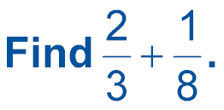
Example 1
Write in simplest form.
A.
B.
C.
D.

Slide 14
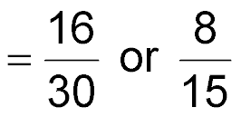
Example 2
Add Fractions and Mixed Numbers
A.
Estimate 1 + 0 = 1
The LCD of 6 and 10 is 30.
Rename each fraction with the LCD.
Simplify.
Answer:

Slide 15
Example 2
Add Fractions and Mixed Numbers
B.
Write the mixed numbers as improper fractions.
The LCD of 8 and 3 is 24.
Rename fractions using the LCD, 24.

Slide 16
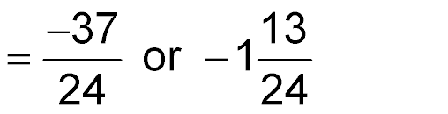
Example 2
Add Fractions and Mixed Numbers
Simplify.

Slide 17
Example 2
A.
A.
B.
C.
D.

Slide 18
Example 2
B.
A.
B.
C.
D.

Slide 19
Concept

Slide 20
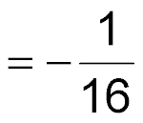
Example 3
Subtract Fractions and Mixed Numbers
A.
The LCD is 16.
Rename using the LCD.
Subtract.
Answer:

Slide 21
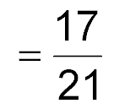
Example 3
Subtract Fractions and Mixed Numbers
B.
Write as improper fractions.
The LCD is 21.
Rename using the LCD.
Simplify.
Answer:

Slide 22
Example 3
A.
A.
B.
C.
D.

Slide 23
Example 3
B.
A.
B.
C.
D.

Slide 24
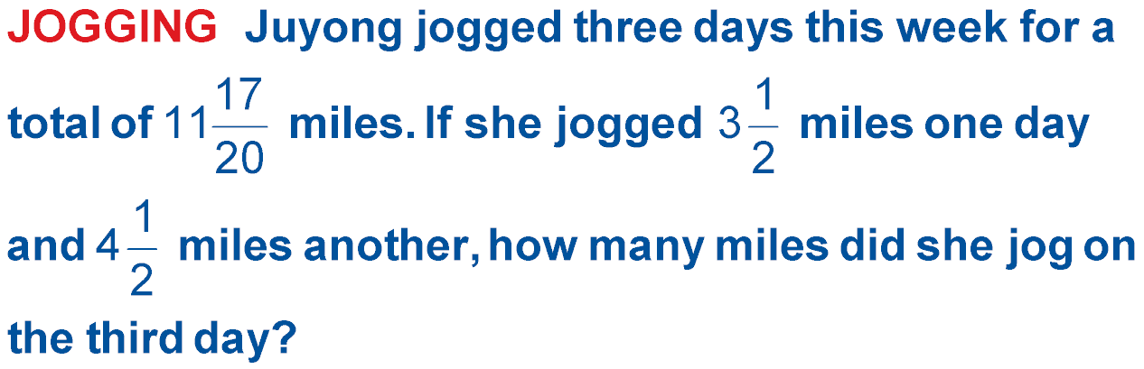
Example 4
Add and Subtract Mixed Numbers
Understand You know the total distance Juyong jogged and the distances on two days.

Slide 25
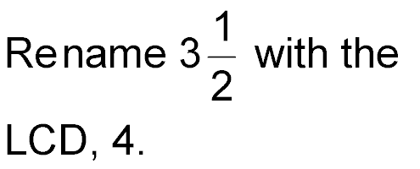
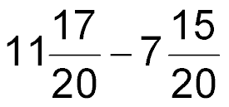
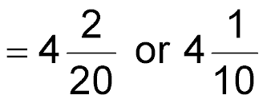
Example 4
Add and Subtract Mixed Numbers
Simplify
Simplify.

Slide 26
Example 4
Add and Subtract Mixed Numbers
Check

Slide 27
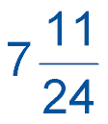
Example 4
GARDENING Howard’s tomato plants grew a total of inches during the first three weeks after sprouting. If they grew inches during the first week and inches during the second week, how much did they grow during the third week after sprouting?
A. B.
C. D.

Slide 28
End of the Lesson

